Slide 1
Markets products Analysis
Abdelrahman Ahmed Medhat 202002045
Youssef Abbas Mohamed 202001428

Slide 2
AGENDA
Introduction
Primary goals
Analysis report
Result
Conclusion

Slide 3
INTRODUCTION
The document addresses the need for businesses to understand pricing and discount trends in different markets to make informed decisions. By analysing the products' pricing and discount trends across three markets, we can identify patterns and insights that can help businesses improve their pricing strategies and increase their competitiveness. Our project also demonstrates the effectiveness of data mining techniques and tools such as Power BI in analyzing complex data and identifying hidden patterns and insights.

Slide 4
PRIMARY GOALS
understand pricing and discount trends in different markets to make informed decisions.

Slide 5
Analysis report

Slide 6

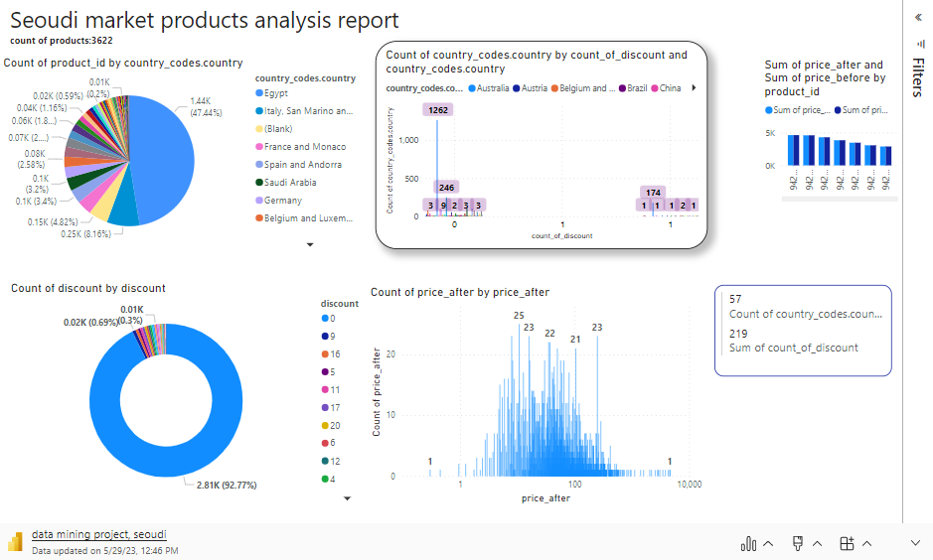

Slide 7
Seoudi market products analysis report count of products:3622
Exporting countries
Discounts
Prices after discounts
Count of products was highest for Egypt at 1,436, followed by Italy, San Marino and Vatican City, and France and Monaco.
The count of products was lowest for Brazil at 5.
Egypt accounted for 47.44% of Count of products.﻿﻿ ﻿﻿ ﻿The count
﻿Count of discount was highest for 0 at 2,808, followed by 9 and 16.﻿﻿ ﻿﻿ ﻿
﻿0 accounted for 92.77% of Count of discount.﻿﻿ ﻿
10.75 had the highest Count of price after discounts at 25, followed by 7.95 and 15.95, which tied for second at 23.﻿﻿ ﻿﻿ ﻿﻿10.75 accounted for 0.83% of the Count of price after.﻿﻿ ﻿﻿
﻿﻿Across all 822 price_after discounts, the Count of price_after discounts ranged from 1 to 25.﻿﻿ ﻿﻿ ﻿

Slide 8

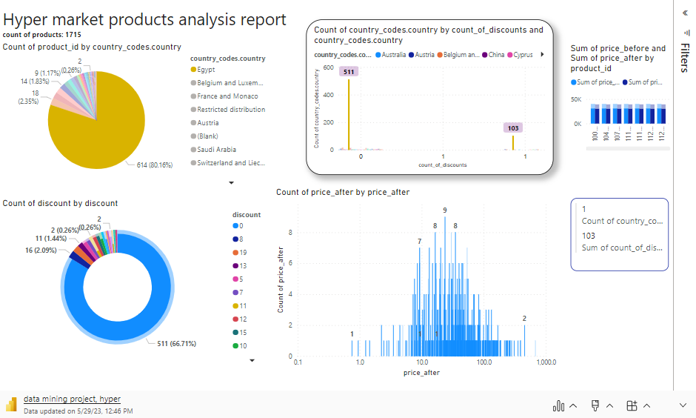

Slide 9
Hyper market products analysis report count of products: 1715
Exporting countries
Discounts
Prices after discounts
Count of products was highest for Egypt at 614, followed by Belgium and Luxembourg and France and Monaco Count of products was highest for Brazil at 5.
Egypt accounted for 80.16% of Count of products.﻿﻿ ﻿﻿ ﻿
﻿Count of discount was highest for 0 at 642, followed by 8 and 19.
﻿0 accounted for 83.81% of Count of discount.﻿﻿ ﻿
23.75 had the highest Count of price after at 9, followed by 16.50 and 34.95, which tied for second at 8.﻿﻿ ﻿﻿ ﻿﻿23.75 accounted for 1.17% of the Count of price after.
﻿﻿﻿Across all 413 price_after, the Count of price_after ranged from 1 to 9.﻿﻿ ﻿﻿ ﻿

Slide 10

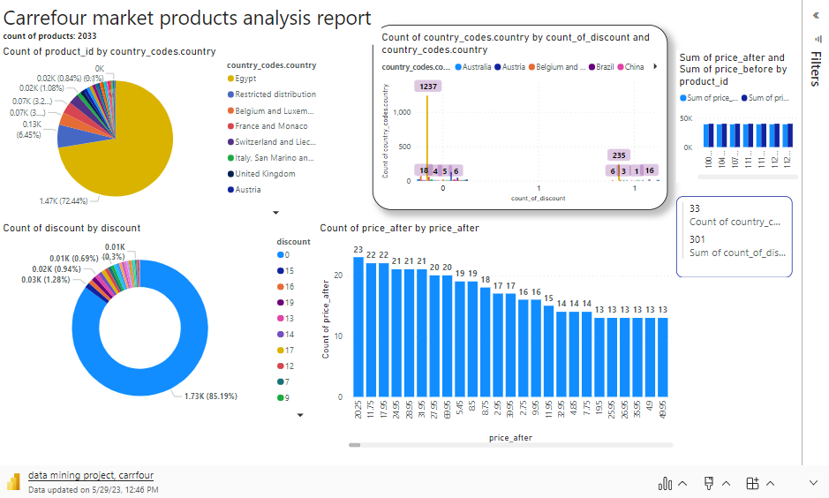
AREAS OF GROWTH

Slide 11
Carrefour market products analysis report count of products: 2033
Exporting countries
Prices after discounts
Discounts
Count of products was highest for Egypt at 1,472, followed by Restricted distribution and Belgium and Luxembourg.
Egypt accounted for 72.44% of Count of products.﻿﻿ ﻿﻿ ﻿
﻿0 had the highest Count of discounts at 1,731, followed by 15 and 19. 30 had the lowest Count of discount at 1.﻿﻿
﻿﻿0 accounted for 85.19% of the Count of discounts.﻿﻿
﻿﻿
﻿
﻿20.25 had the highest Count of price_after at 23, followed by 17.95 and 11.75, which tied for second at 22.﻿﻿ ﻿﻿ ﻿﻿
20.25 accounted for 1.13% of Count of price_after.﻿﻿
﻿Across all 650 price_after, Count of price_after ranged from 1 to 23.﻿﻿ ﻿﻿ ﻿

Slide 12
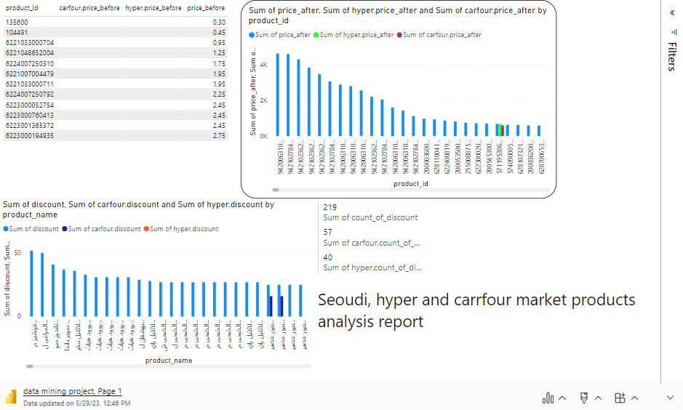

Slide 13
Seoudi, hyper and Carrefour market products analysis report
﻿At 4,631.45, 9420063101208 had the highest Sum of price_after and was 1,543,716.67% higher than 135600, which had the lowest Sum of price_after at 0.30.
﻿﻿Across all 3,022 product_name, Sum of seoudi.discount ranged from 0 to 52, Sum of carfour.discount ranged from 0 to 30, and Sum of hyper.discount ranged from 0 to 19.
﻿Across all 3,027 product_id, Sum of price_after ranged from 0.30 to 4,631.45, Sum of hyper.price_after ranged from 5.50 to 679.95, and Sum of carfour.price_after ranged from 0.75 to 600.

Slide 14
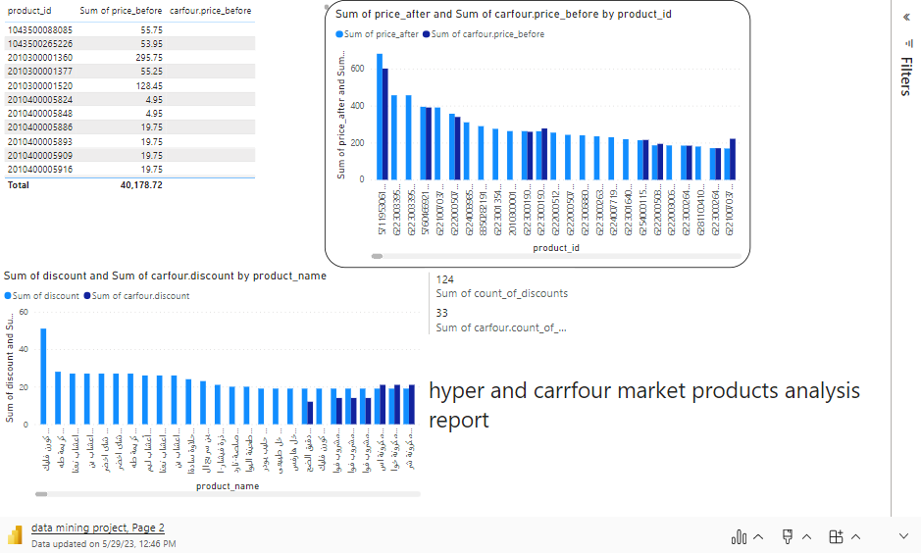

Slide 15
hyper and Carrefour market products analysis report
﻿At 679.95, 5711953061134 had the highest Sum of price_after and was 90,270.69% higher than 6223001030409, which had the lowest Sum of price_after at 0.75.﻿﻿

Slide 16
result
Seoudi market data set consists of 3622 products where they were from 57 countries. 1436 products were from Egypt, while 247 were from Italy, San Marino, and Vatican City. Also, it consists of 219 products with discounts. The range of the prices of products starts at 0.3 and ends at 4631.
Hyper market data set consists of 1715 products, where they were from 29 countries. 614 products were from Egypt, while 18 were from Italy, San Marino, and Vatican City. Also, it consists of 124 products with discounts. The range of the prices of products starts at 0.75 and ends at 678.
carrefour market data set consists of 2033 products, where they were from 33 countries. 1472 products were from Egypt, while 131 were from Restricted distribution. Also, it consists of 301 products with discounts. The range of the prices of products starts at 0.65 and ends at 99.95.

Slide 17
conclusion
This paper presents a data mining project that analyses product pricing and discount trends across three different markets. The project's primary objectives are to determine the range of product prices, count the products with discounts in each market, and identify the best-priced supermarket. The project utilizes Power BI, a powerful data analysis and visualization tool, to import and clean data from three different Excel sheets. Create visualizations that display the range of product prices, the number of products with discounts, and the relationship between the three markets, and calculate the average price, discount rate, and other relevant metrics for each market and product. Additionally, the project integrates information about the country of manufacture for each product extracted from the barcode. The results provide valuable insights into the three markets' products, their pricing and discount trends, and their relationships. The project demonstrates the effectiveness of data mining techniques and tools in analyzing complex data and identifying hidden patterns and insights.

Slide 18
THANK YOU
Abdelrahman Ahmed Medhat 202002045
Youssef Abbas Mohamed 202001428

